Slide 1

Emerging Technologies
Session #02: Creating my bluemix account
IBM Bluemix
The Digital Innovation Platform
Sylvain-Roch WILBERT
s_wilbert@fr.ibm.com
Université Paris - Dauphine

Slide 2
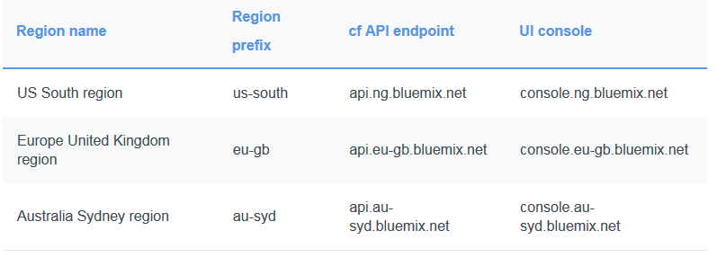
Register to bluemix
https://console.ng.bluemix.net/
You will need :
An email
Remark: Bluemix URLs contains a geographical reference.
For the sessions, we will rely on the US South unless stated

Slide 3
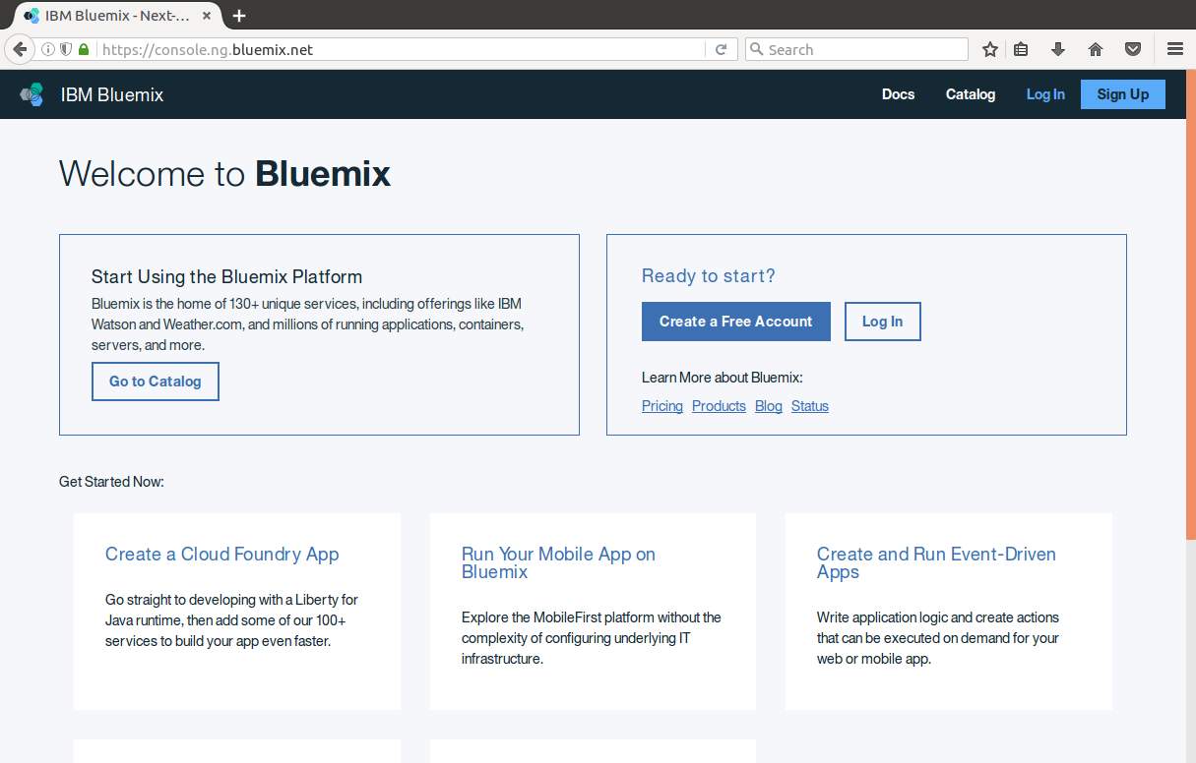

Welcome to Bluemix
Open the URL https://console.ng.bluemix.net/
Click on

Slide 4
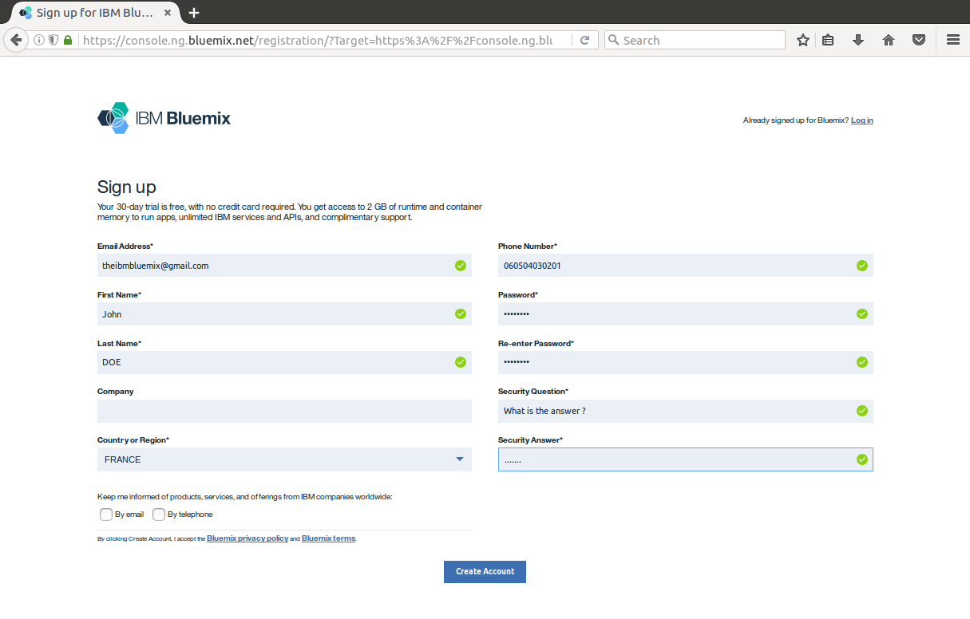
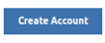
Sign-up in Bluemix
Complete form (Prefer your @dauphine.net account)
Click on

Slide 5
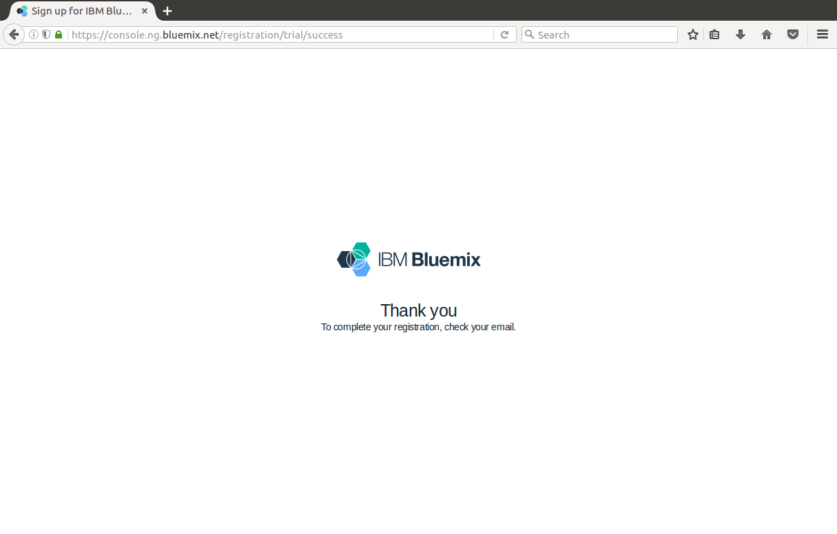
Et voilà

Slide 6
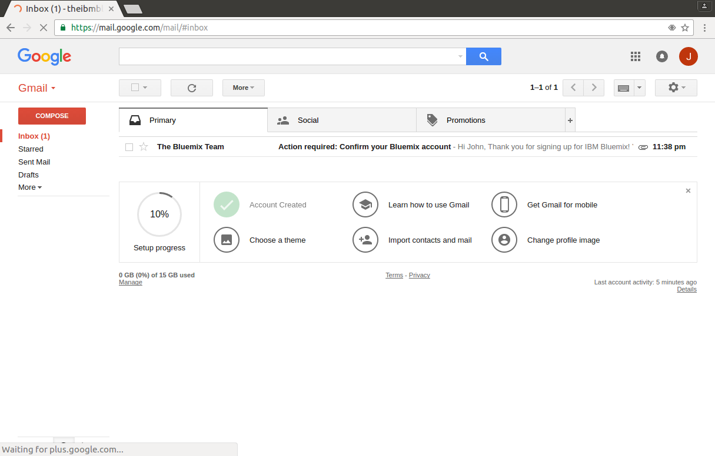
In your mail box
You should have received a mail from The Bluemix Team
Open the e-mail

Slide 7
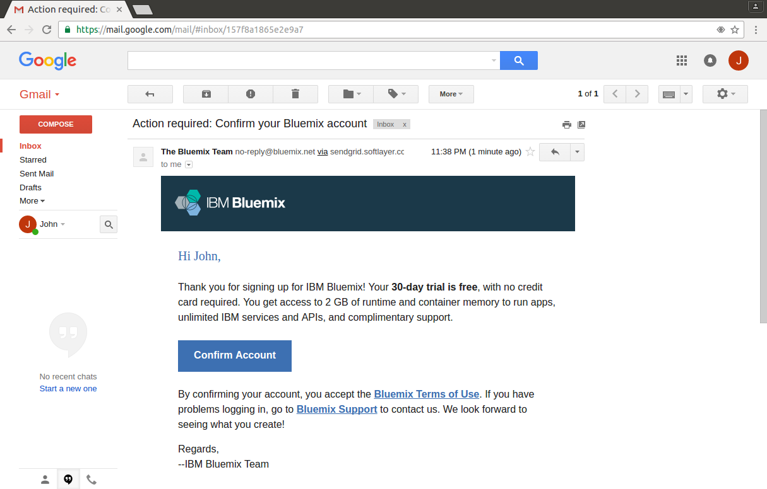
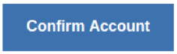
A mail from The Bluemix Team
Click on

Slide 8
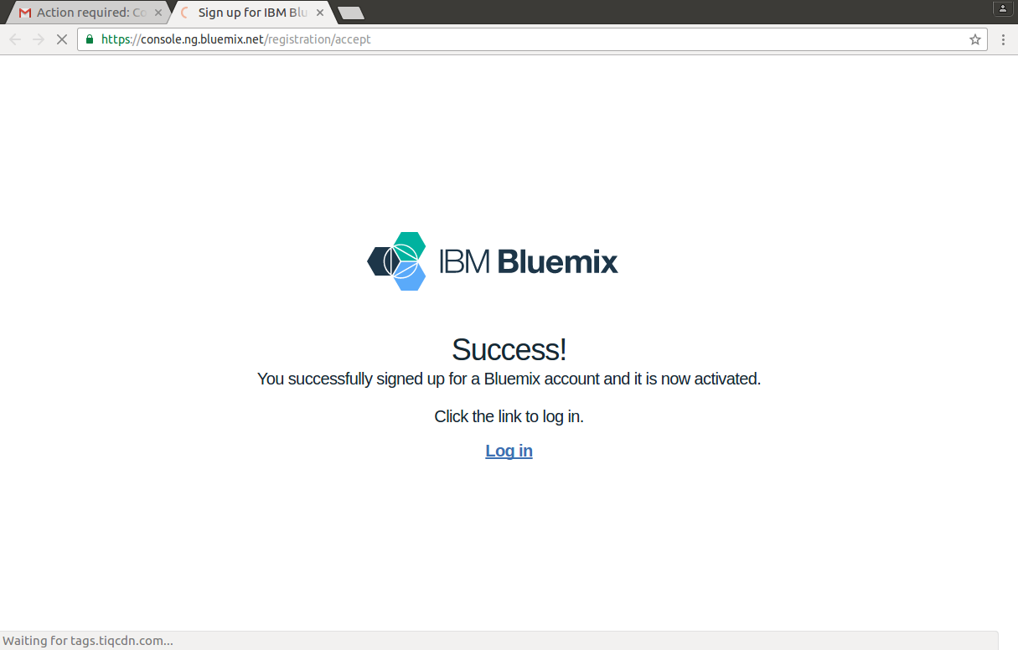
Tadaaa
Your account is created
Click on Log in

Slide 9
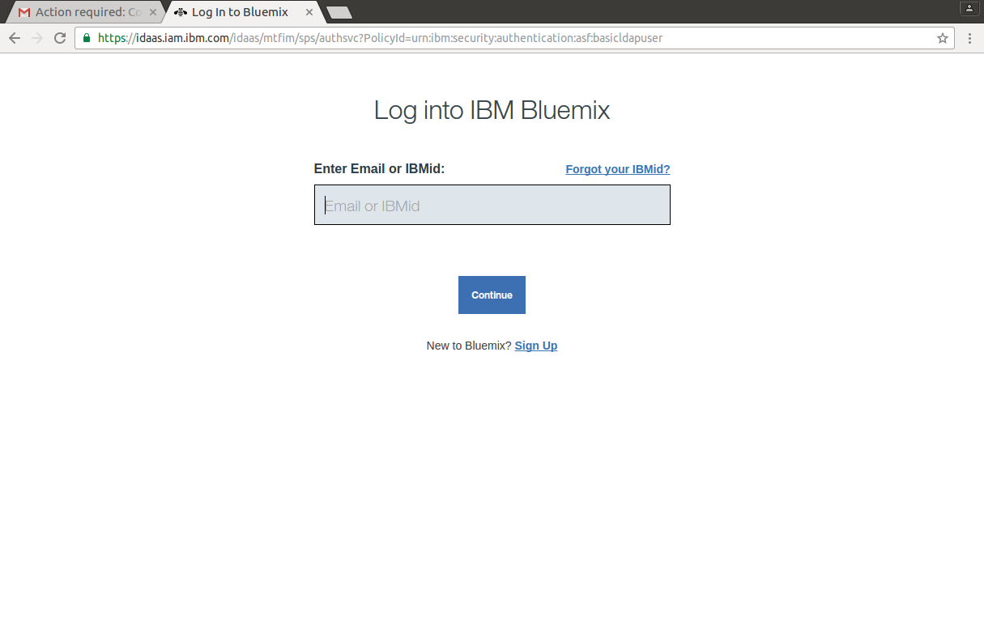
Log in Bluemix

Slide 10
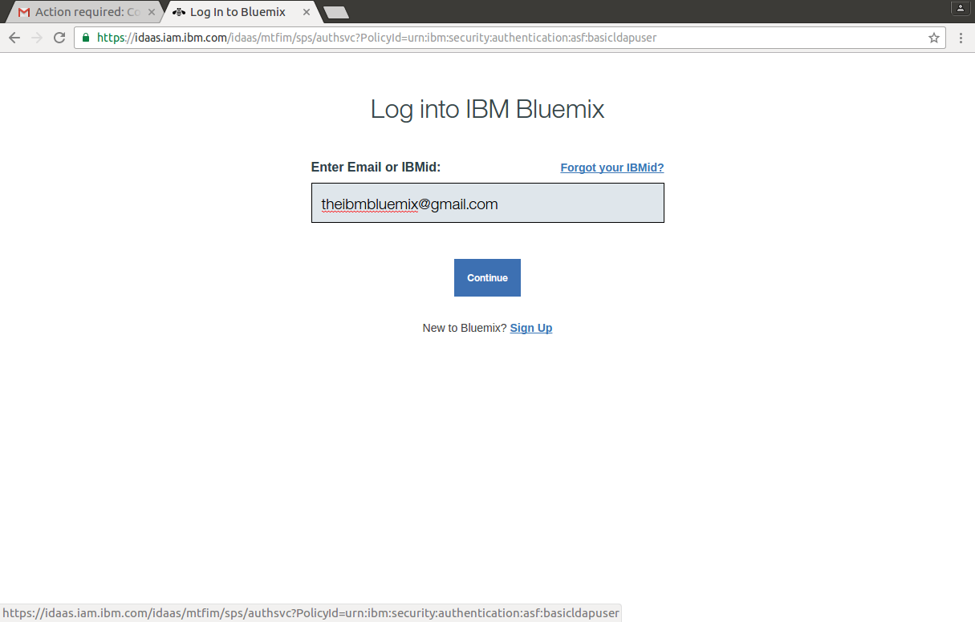
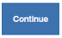
Login
Fill with your email
Click on

Slide 11
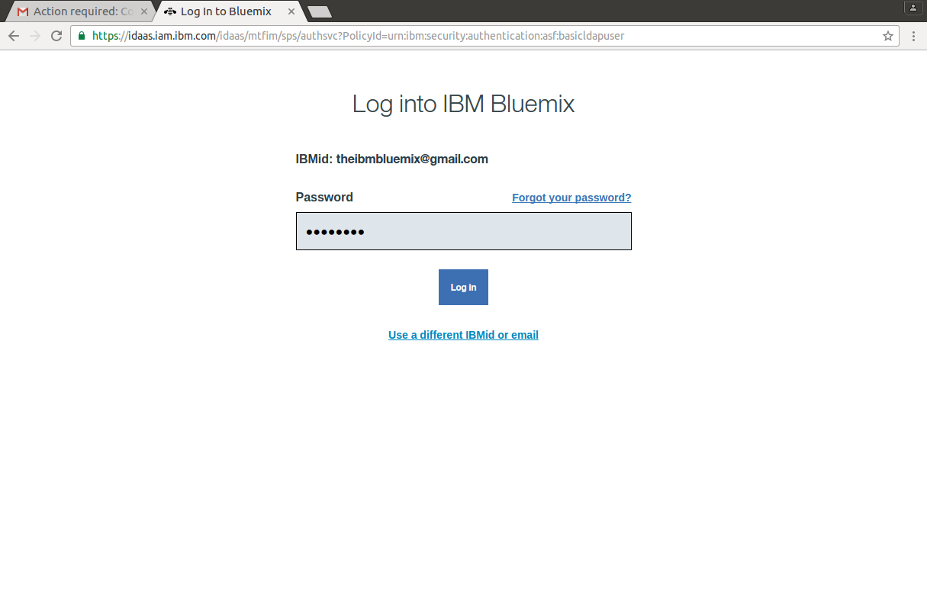
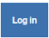
Password
Fill with your password
Click on

Slide 12
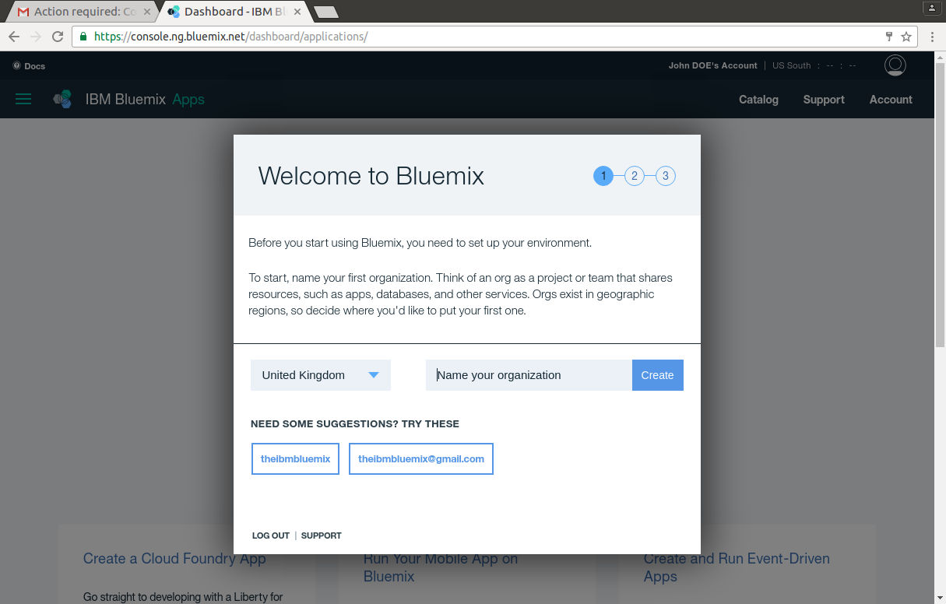
Create an organization (project)
You have to define an organisation (a Project) on a specific geography

Slide 13
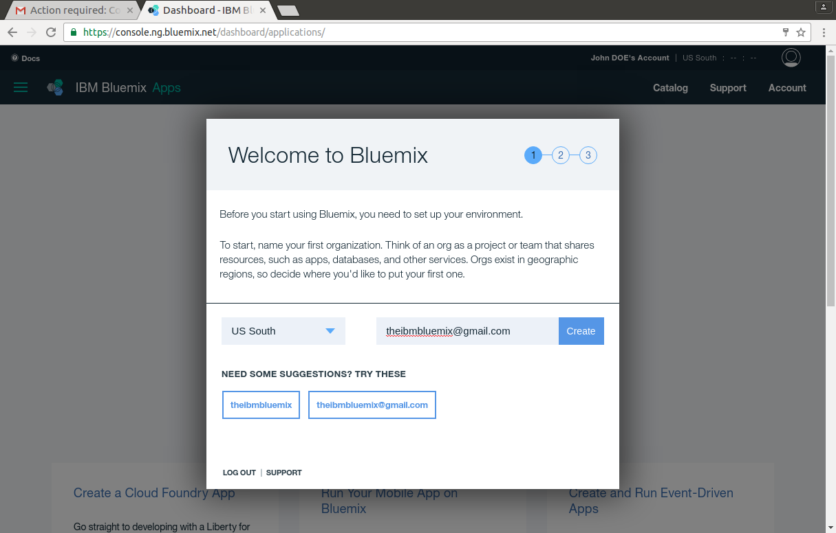
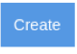
US South
1
2
Select US South
Add your email as the organization name
Click on

Slide 14
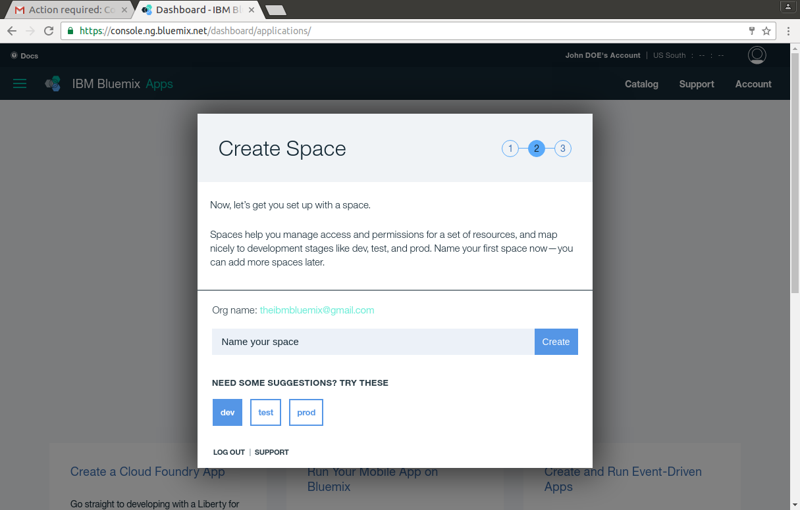
Create a space to host your applications

Slide 15

Call him dev
Create a working Space in your organization. For example dev (development environment)
Click on

Slide 16
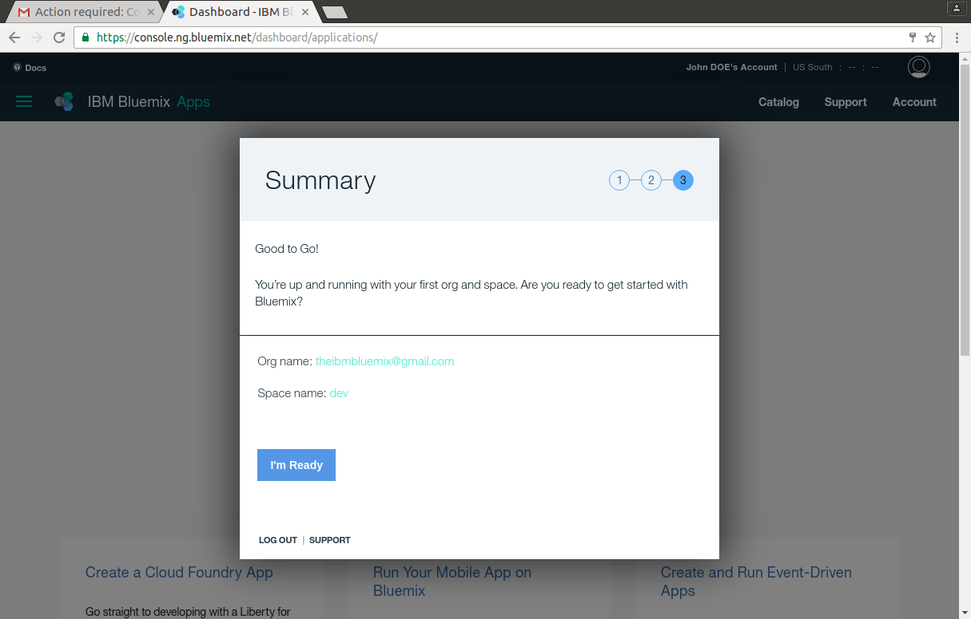

You are ready
Your are all set-up !
To discover your Bluemix click on

Slide 17
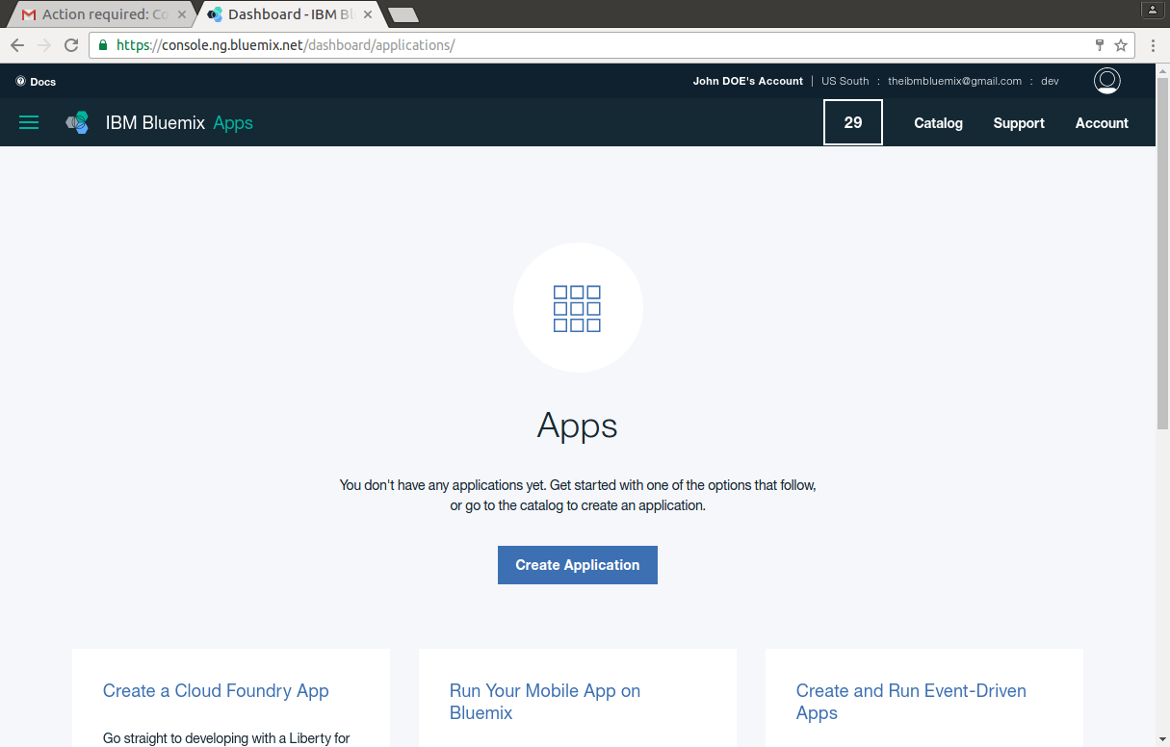
Exploring Bluemix

Slide 18
The IBM Bluemix Homepage

Slide 19
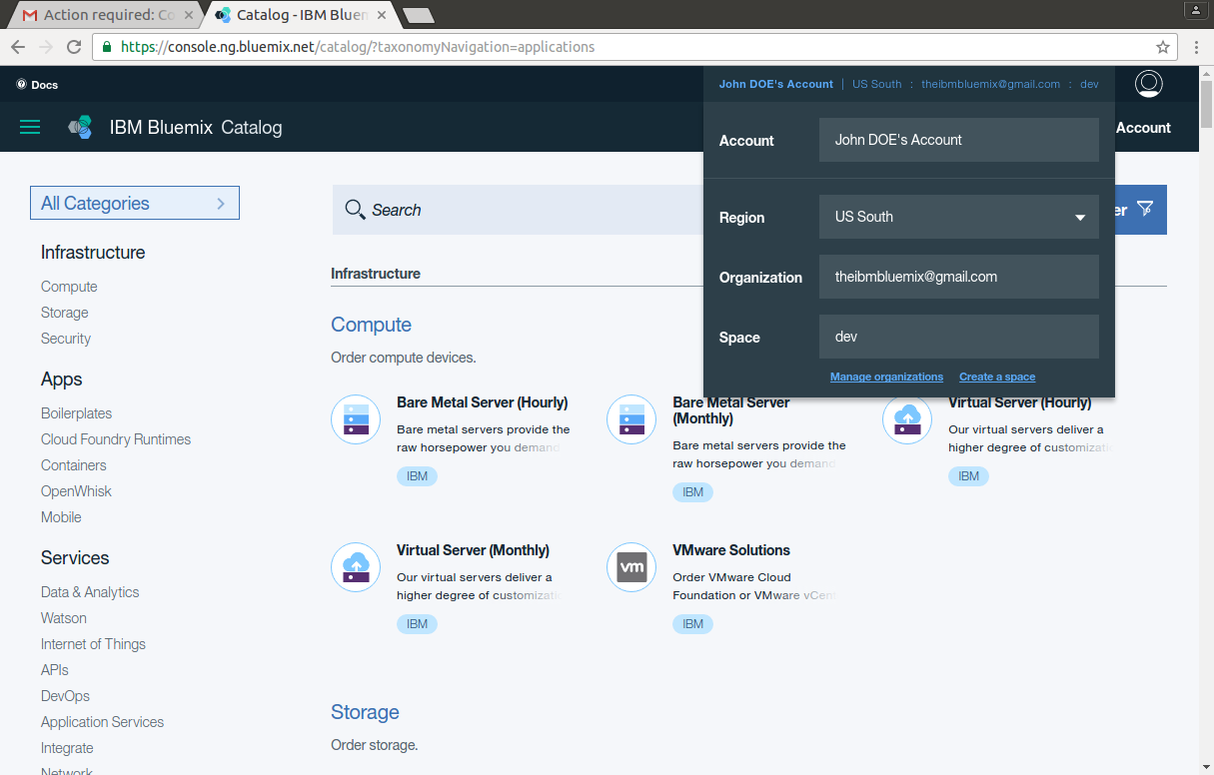
Navigating around the world
1
Navigate across
Regions
Organization
Space

Slide 20
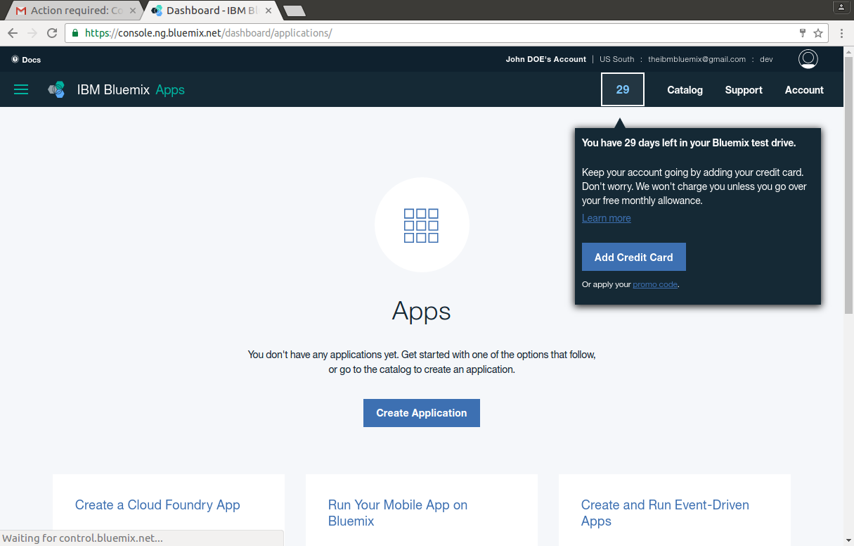
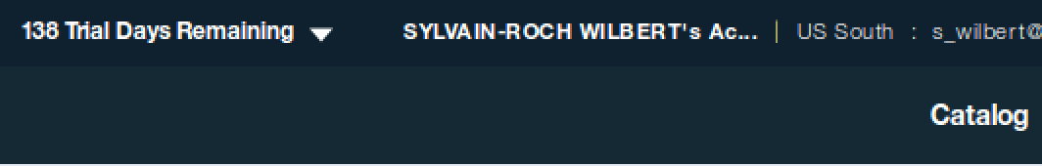
Days of the test drive
1
LAST MINUTE
This counter has been moved to the above status bar (near the account name)
29 corresponds to the remaining days of free test drive
You don’t have to Add a Credit Card ☺ as only free services will be used in the session

Slide 21
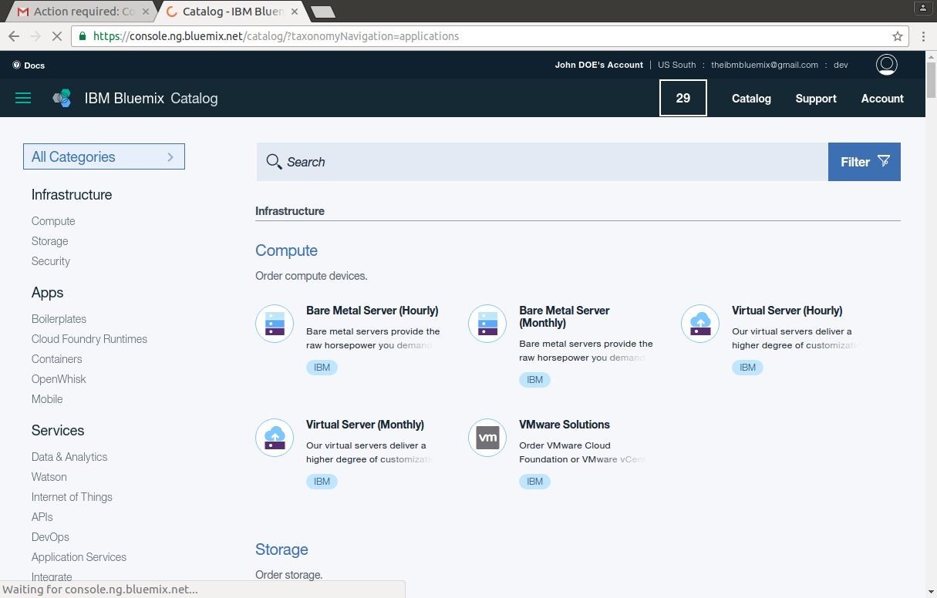

Parsing the catalog
1
Access the service Catalog clicking on
You can browse all the services organized in categories

Slide 22
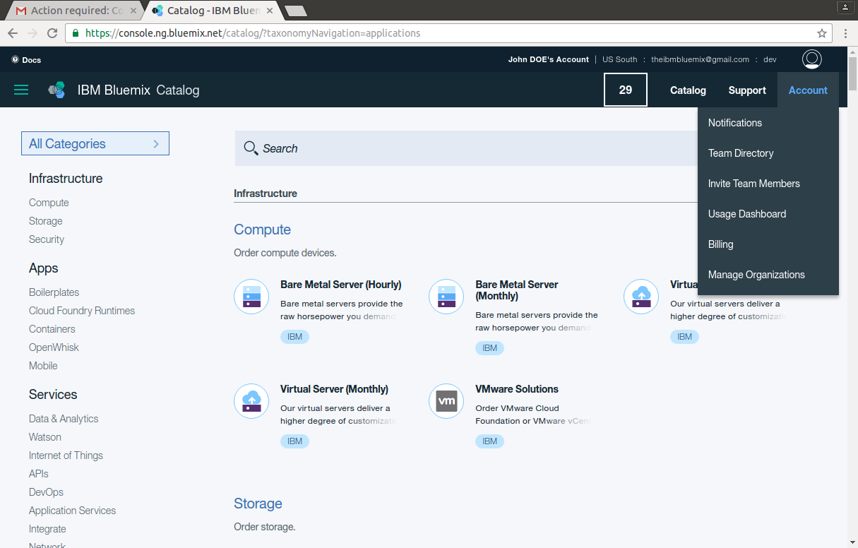
My Account
1
Access to the information related to you account.

Slide 23
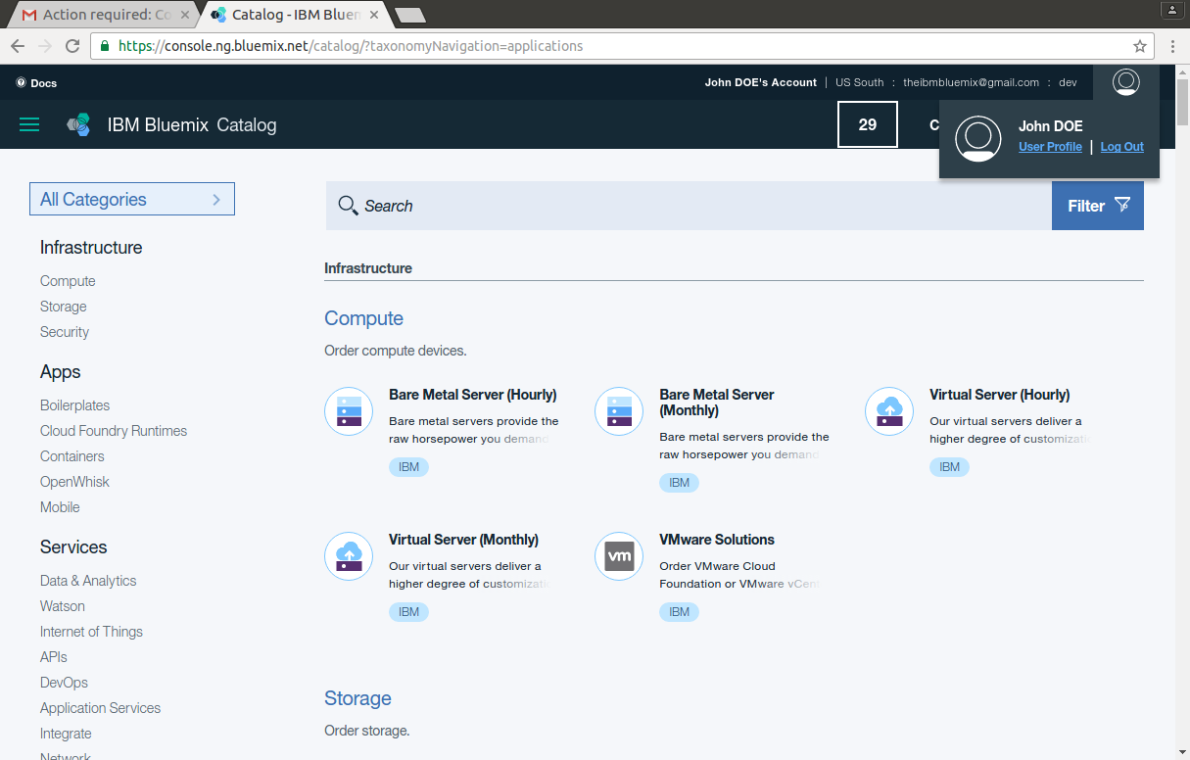
My Account/ My user profile
1
2
Access to the information related to you account (Same than before : Other route).

Slide 24
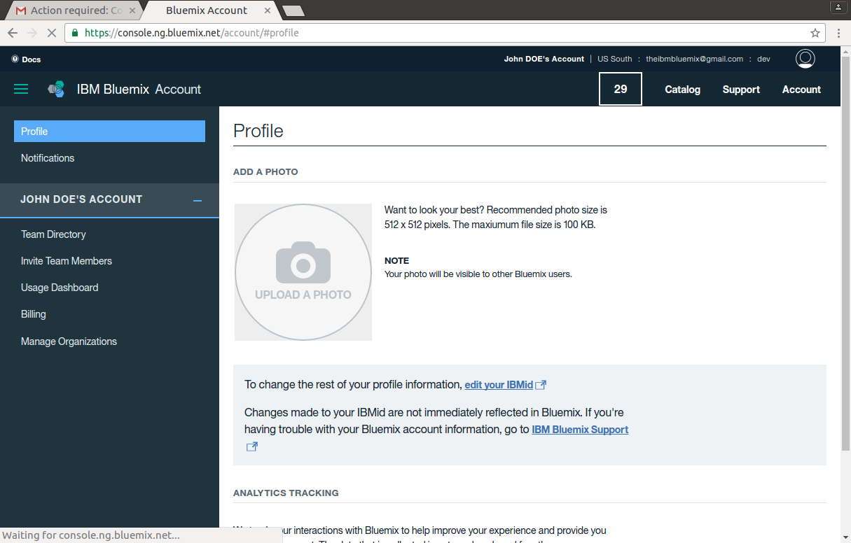
My Profile
Profile
Add your photo

Slide 25
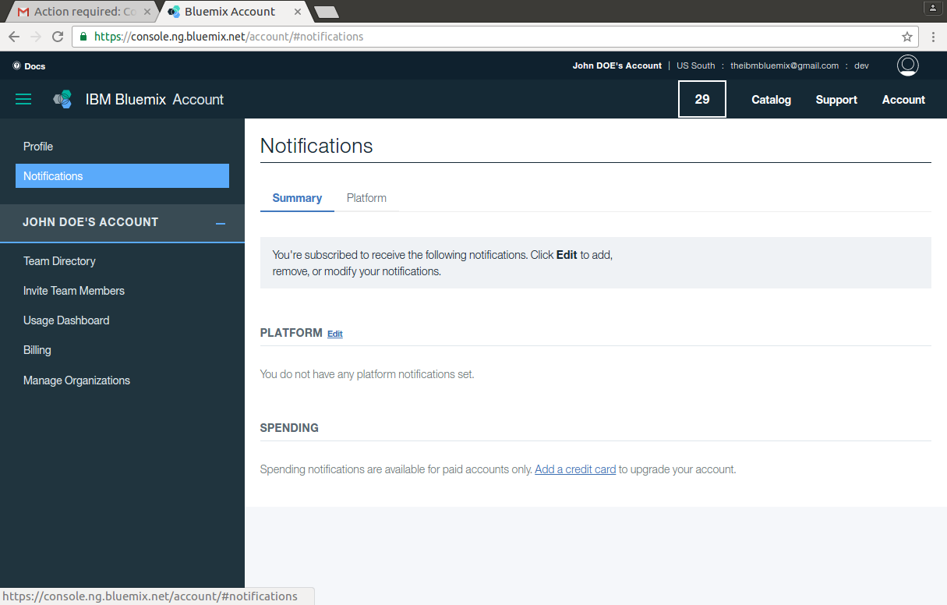
My notifications
Notification
Access all the events that you subscribed (Services spending, Platform status…)

Slide 26
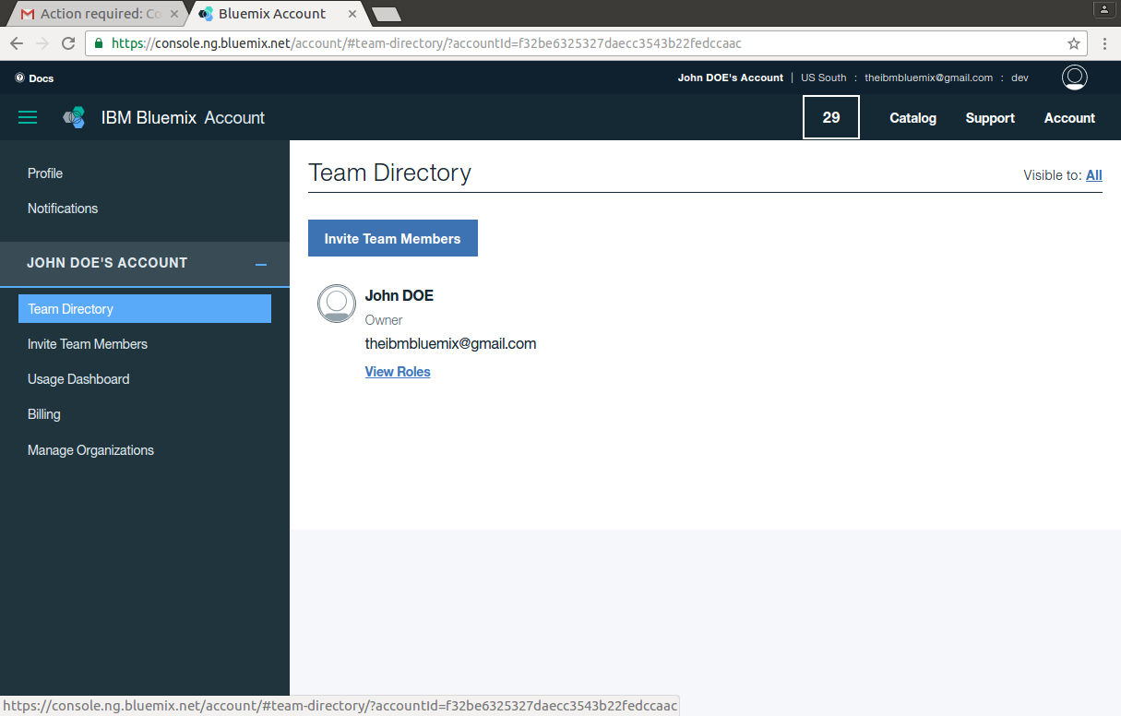
Your Team

Slide 27
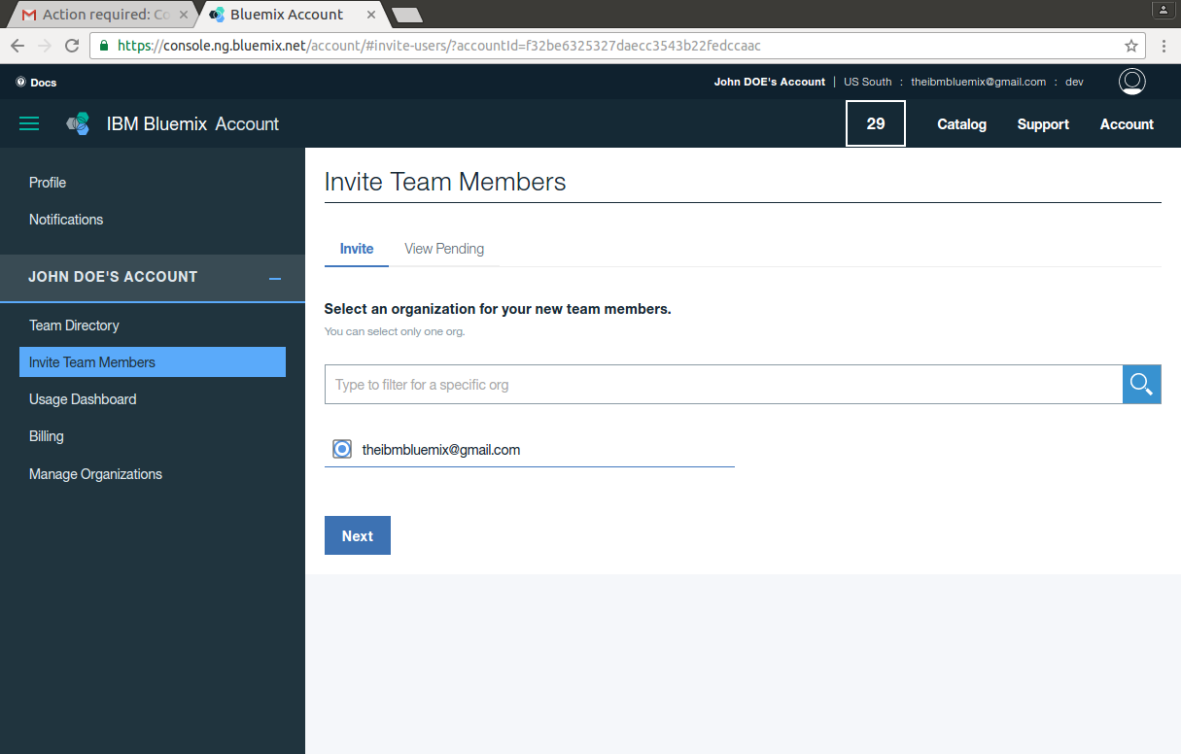
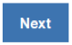
Invite new members
Invite Team Members
Work in teams by opening your space to tiers.
Select an organisation
Click on

Slide 28
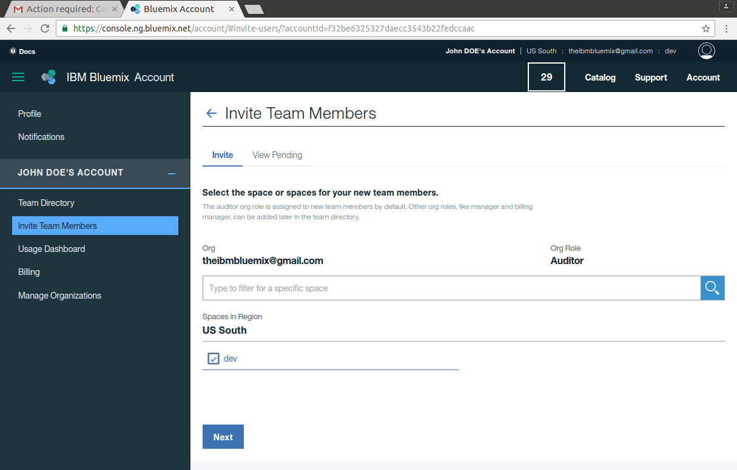
Invite Team Members
Invite Team Members
Select a space to open
Click on

Slide 29
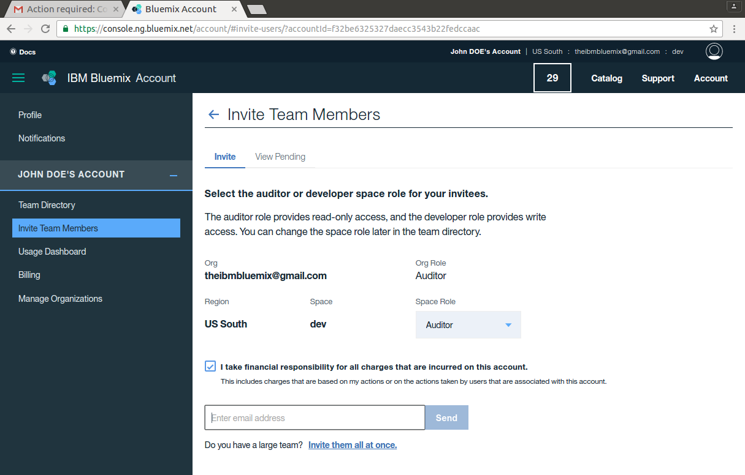

Invite Team Members
Invite Team Members
Enter an email(no necessarily already registered in Bluemix)
Click on
1

Slide 30
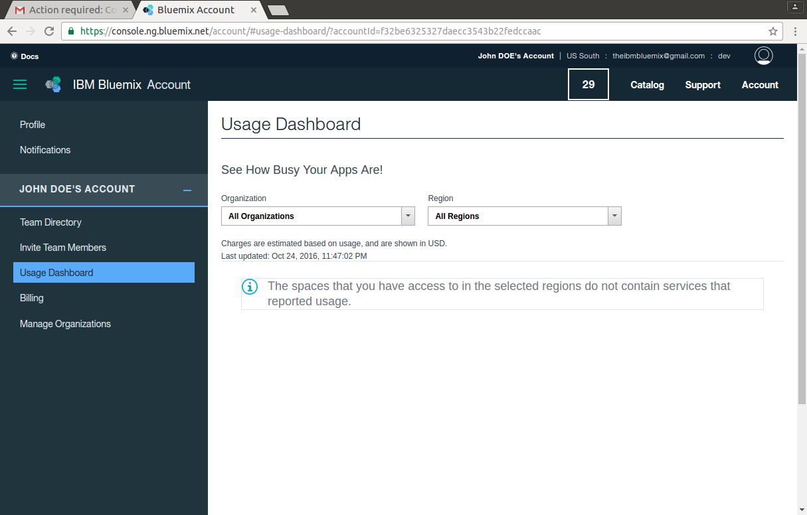
Usage Dashboard
Usage Dashboard
Follow your services’ consumption

Slide 31
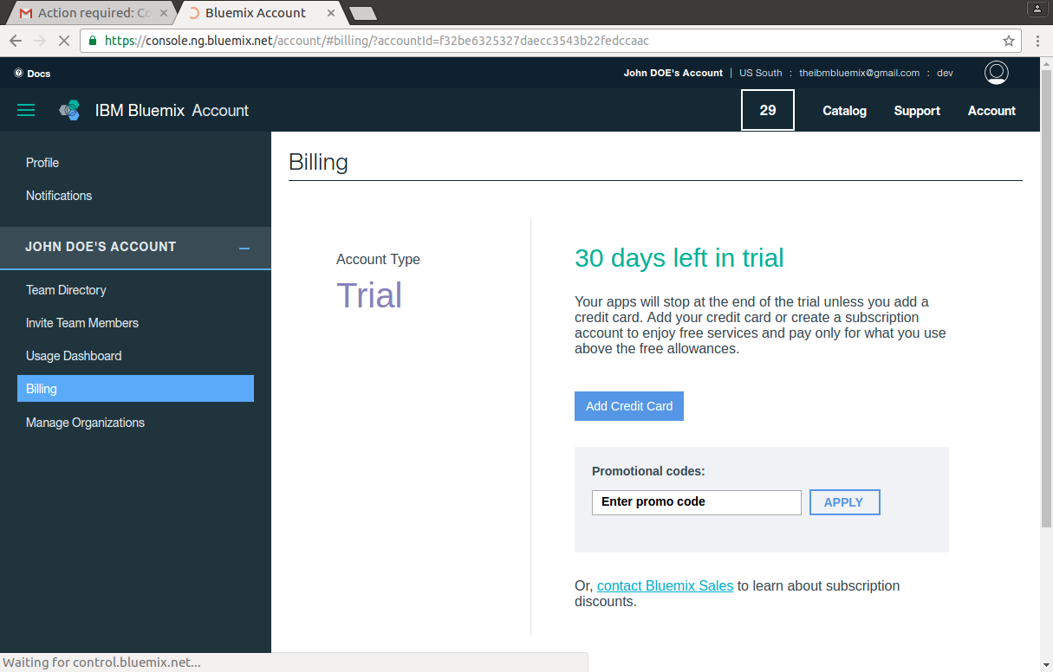
Billing/Promo Code
Promo Code
Insert you promo code here to extend your bluemix account test drive period

Slide 32
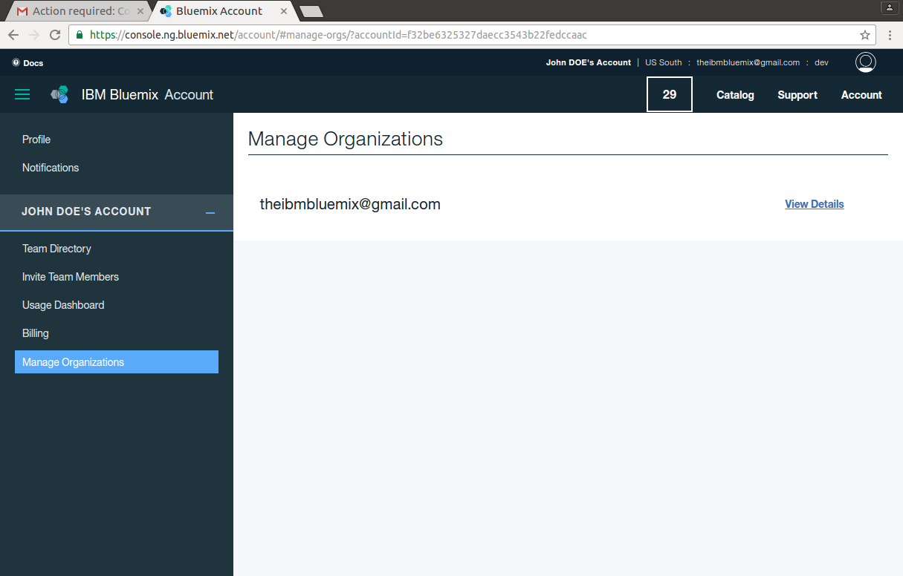
Manage Organizations
Manage Organizations
Manage the different organizations you may have created (1 for the current session)

Slide 33
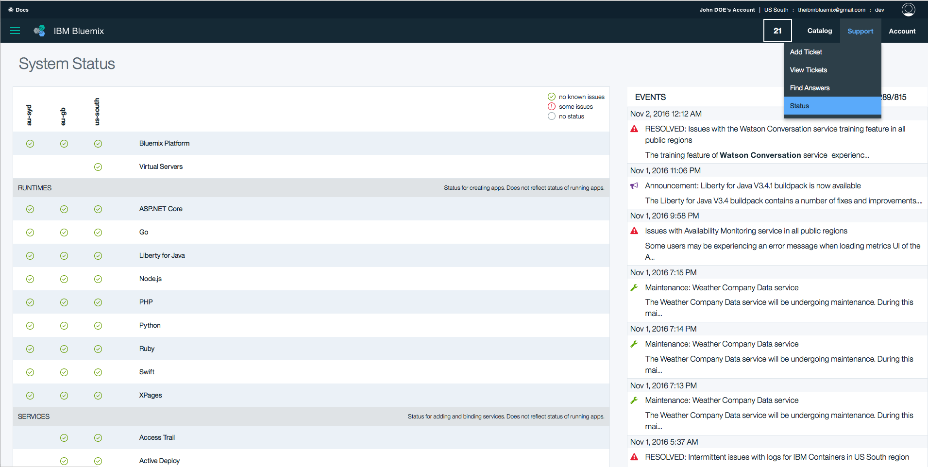
Monitoring IBM Bluemix services
1
2
Monitor the Bluemix status
What is UP what is DOWN, service per service in the different geos

Slide 34
Extending the trial period
For the next session (allow 1 week min for processing)
Exercise 0 : Extend your trial period to 6 months by registering (otherwise the account will be disabled in 30 days.)
- using your dauphine.net email (recommended)
- using an alternate email

Slide 35
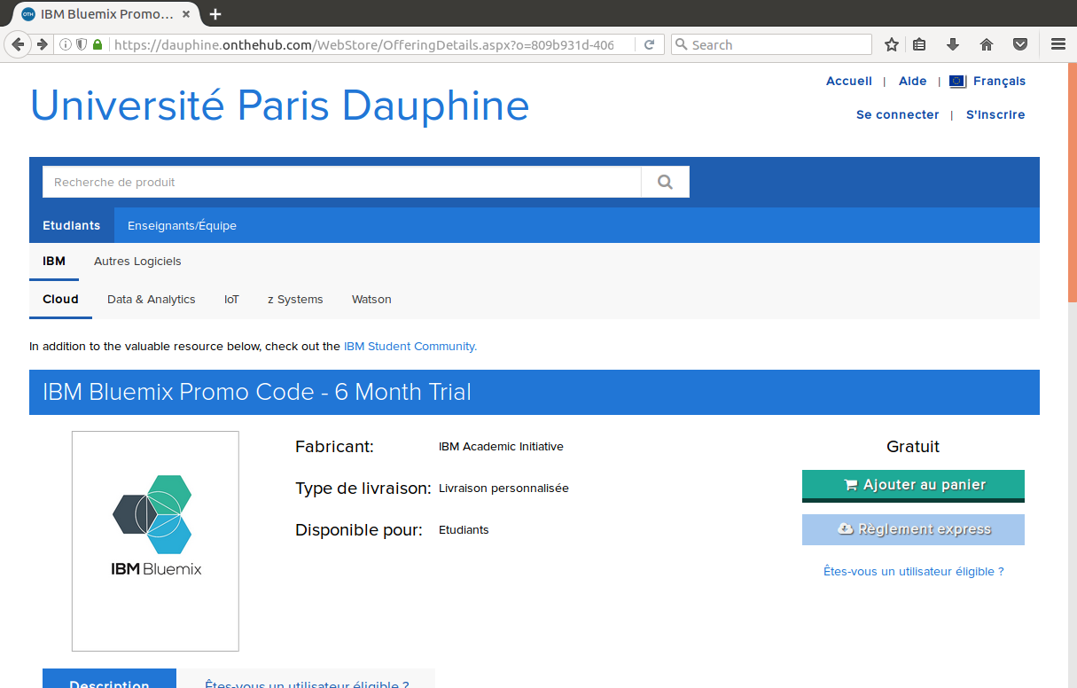
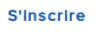
I have setup my account using my dauphine.net email
Open https://dauphine.onthehub.com
Click on

Slide 36
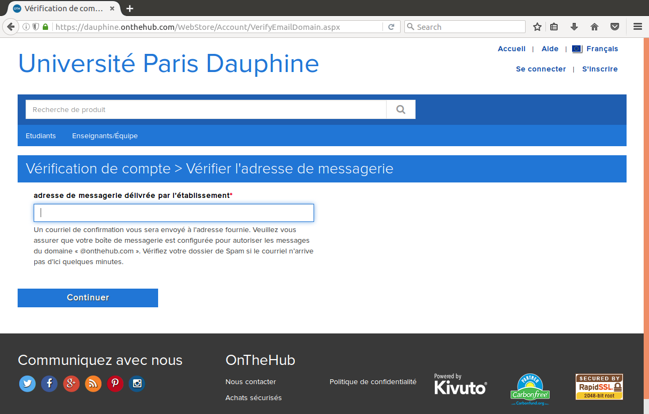

Submit your request
1
Add your dauphine.net email
Click on to receive a confirmation notification

Slide 37
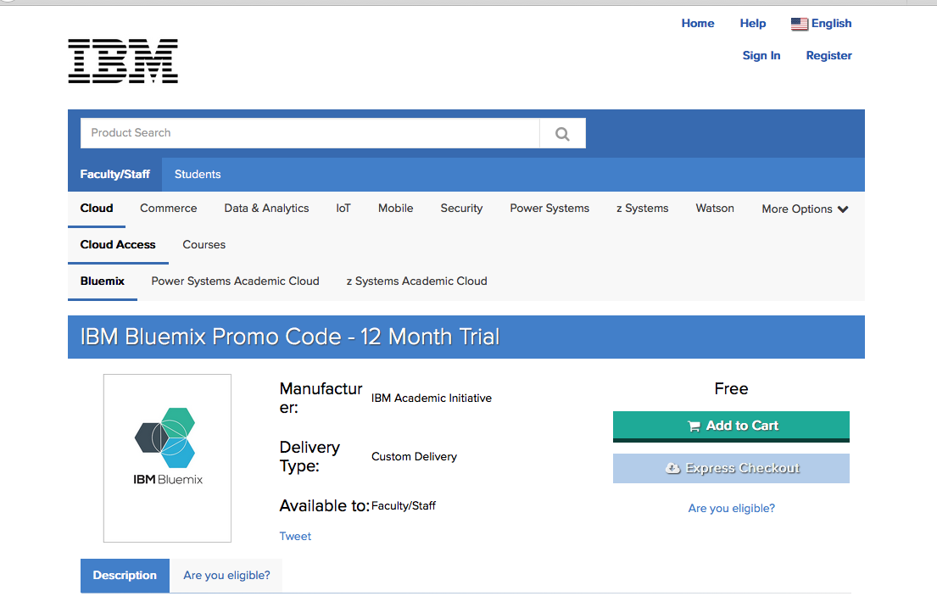
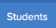
Extending the trial period (alternate process/private email) Not Recommended approach
Open https://ibm.onthehub.com
Click on
Click on

Slide 38
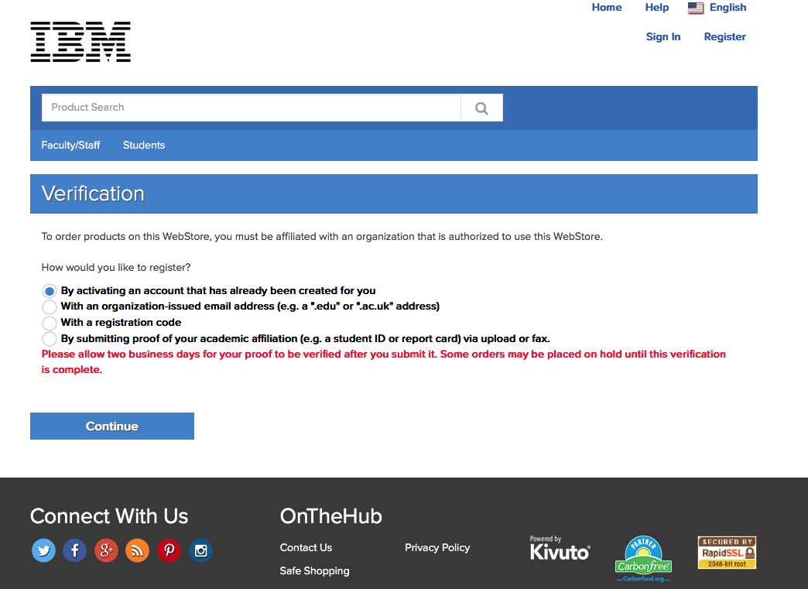
The verification process is initiated
Select ‘By submitting proof…’

Slide 39
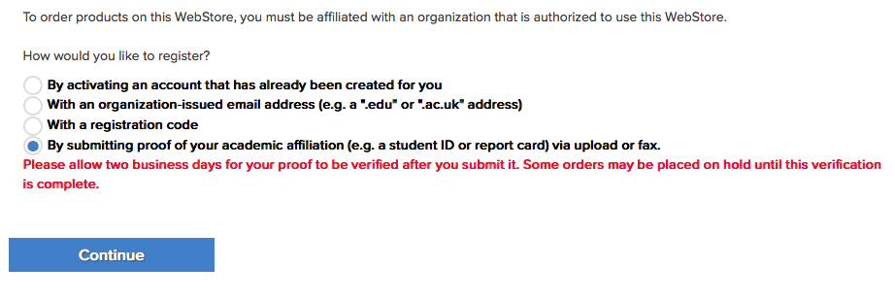

Slide 40
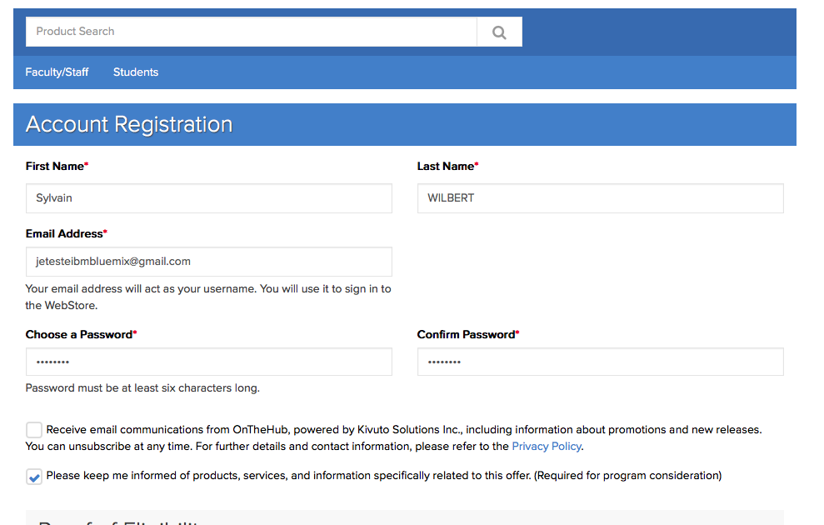

Slide 41
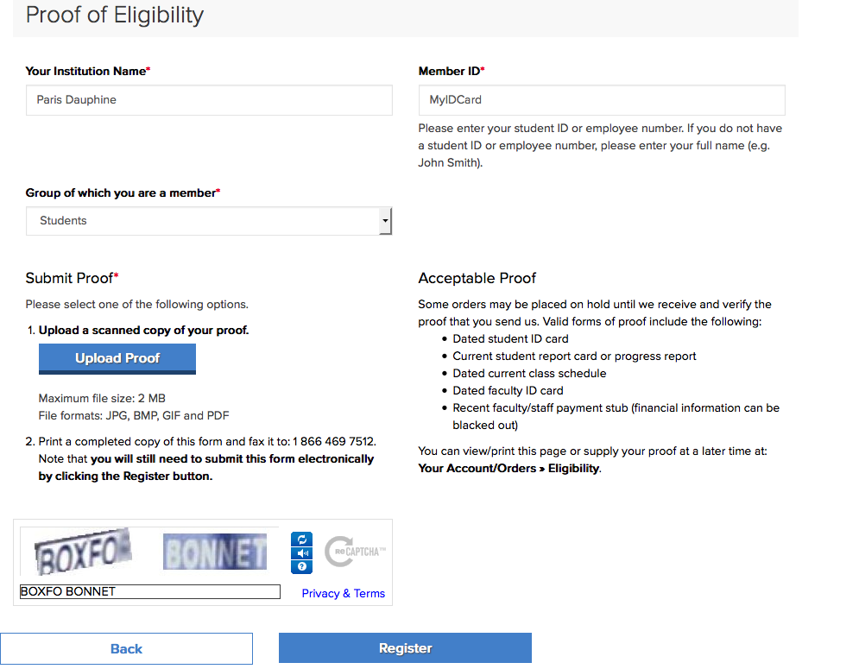

Slide 42
